Slide 1

Information Technology Department Birla Vishwakarma Mahavidyalaya Engineering College (An Autonomous Institution)
Subject: 3IT31- Mini Project
Project Title: Optical Mark Recognize System
Group members: Ashishkumar Dobariya(18IT445)
Mayur Jiyani(18IT446)
Ritul Bathani(18IT447)
Guided by: Prof. Nilesh Prajapati

Slide 2
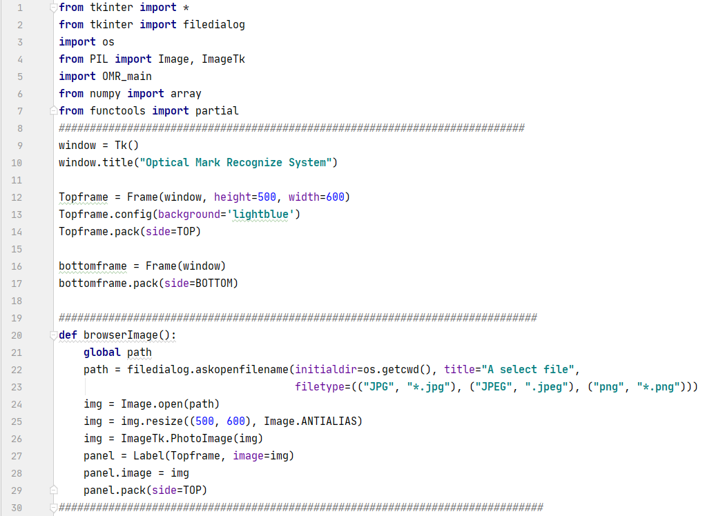
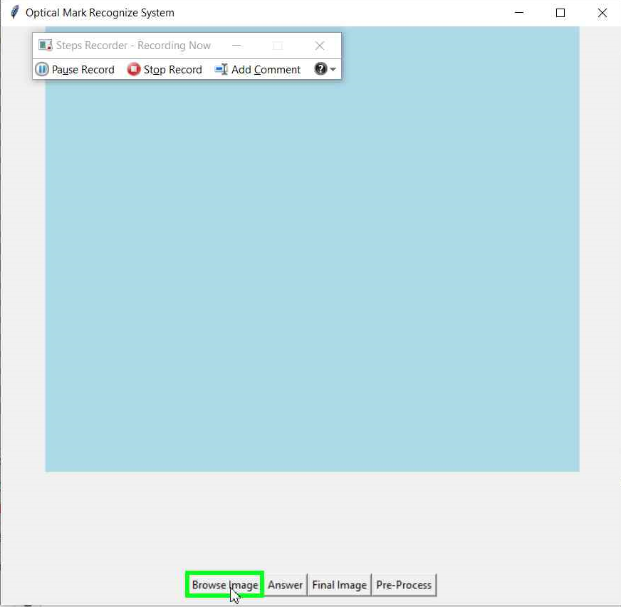
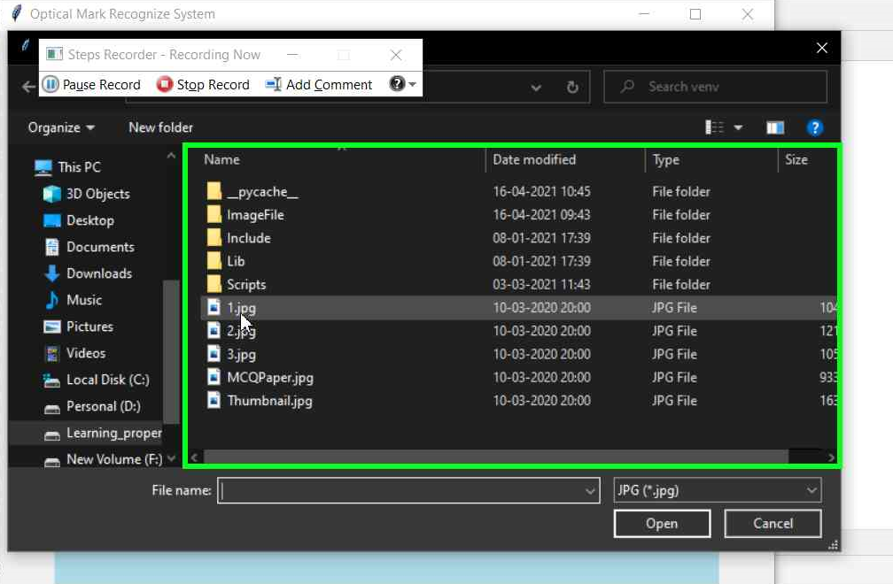
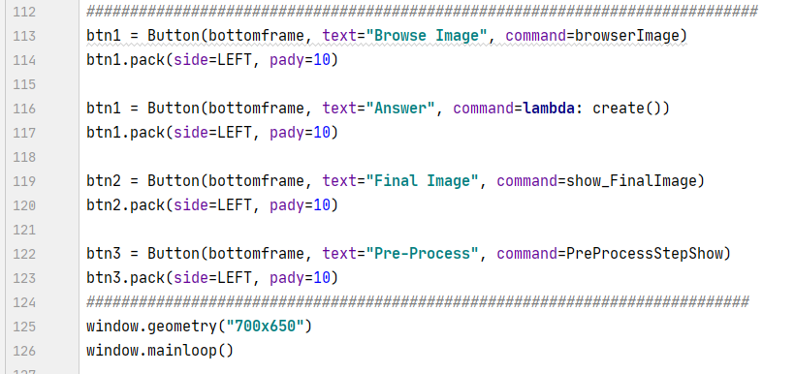
1)Document Processing Model:
Code:

Slide 3
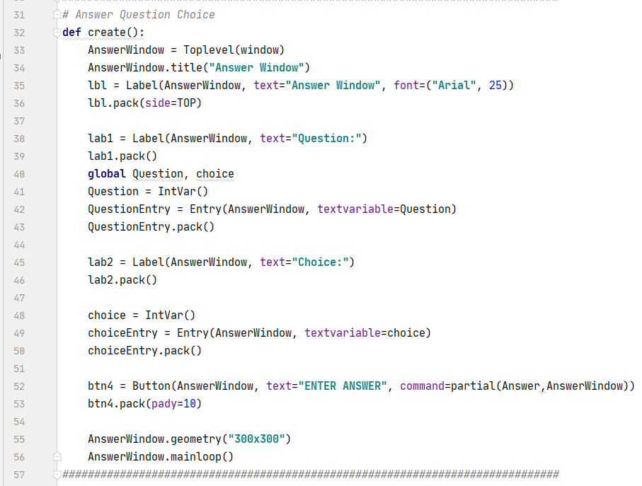
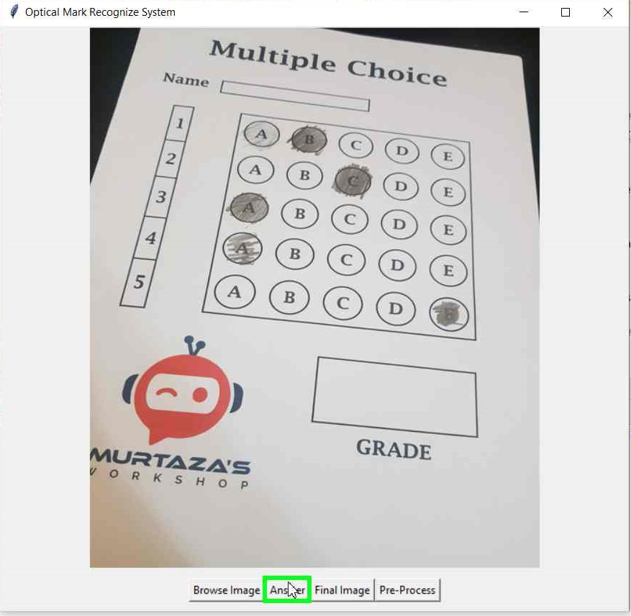
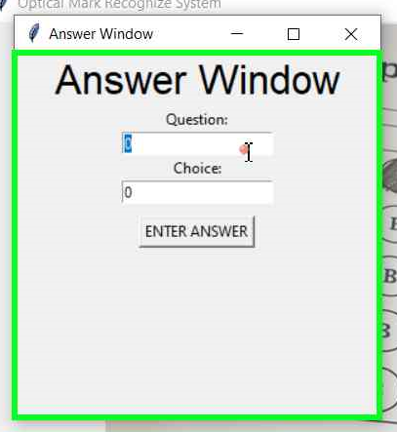

Slide 4
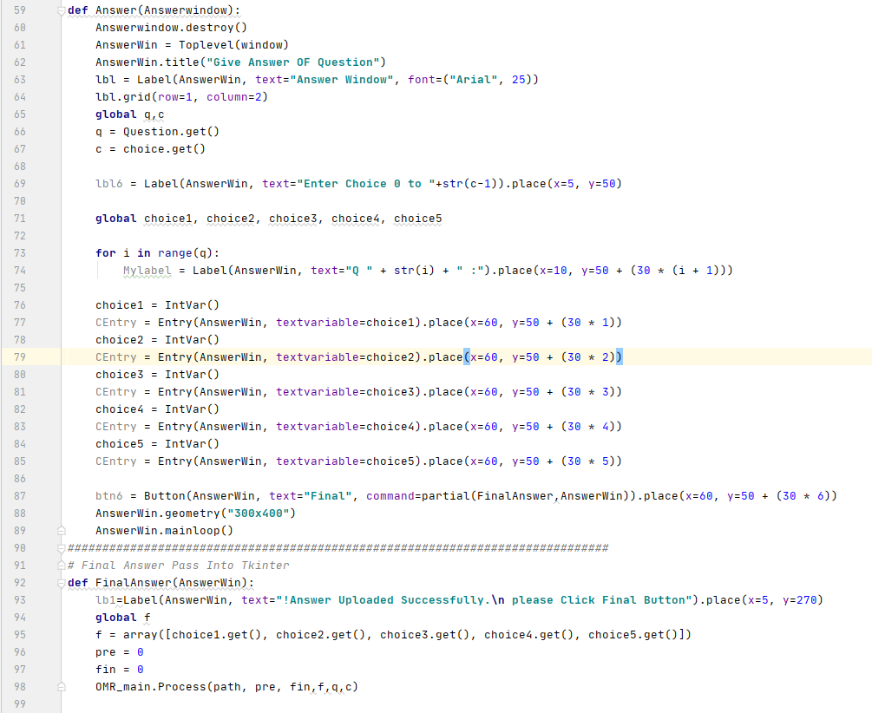
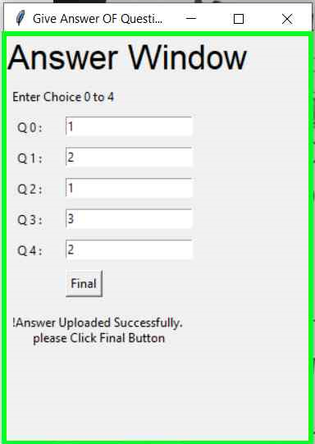

Slide 5
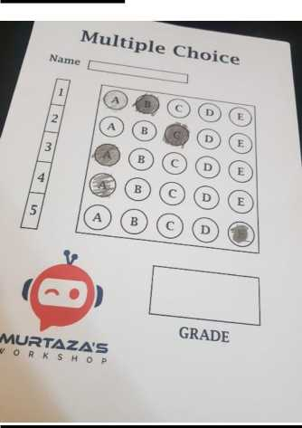
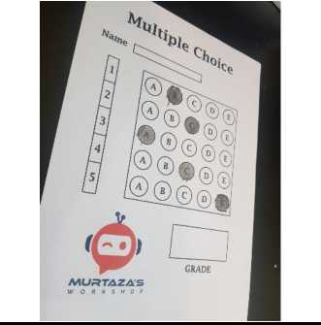
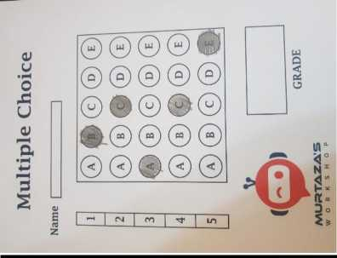
Description:
Browse Image :
When user click on Browse image button then pop up file box will open then user have to select the mark sheet image. Program will set path of the image and it will be proceed further.
Answer Set:
When use press the button “Answer” at that time the GUI of Answer Window will be opened to accept question , choice and also all question correct Answer.
Testing: Testcase 1:
Testcase 2:
Testcase 3:

Slide 6
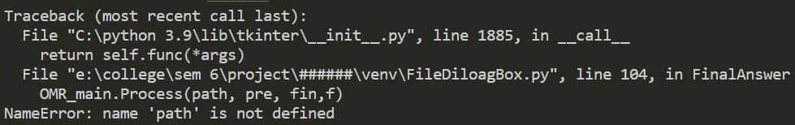
Testcase 4:
If user move further without choosing file or system is unable to find path of the mark sheet at that time , then python console will show name ‘path’ is not defined error will be generated. Which is shown in the below figure:

Slide 7
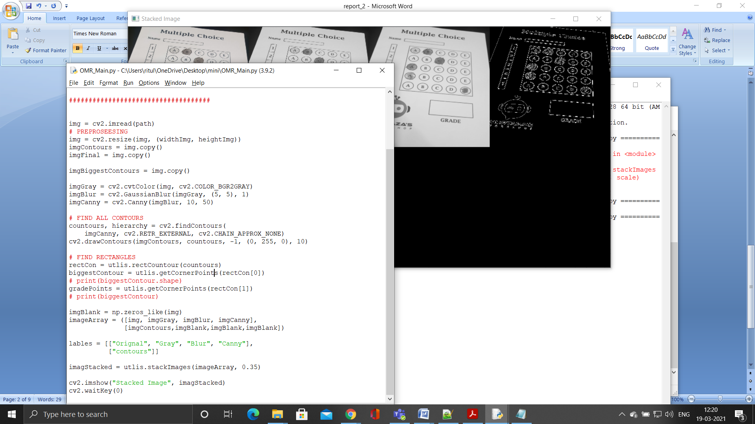
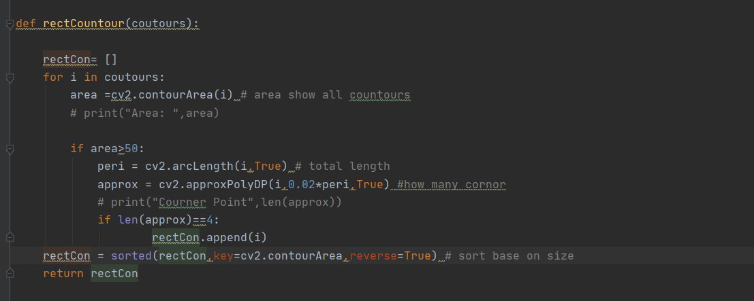
2)System training module:
Code:

Slide 8
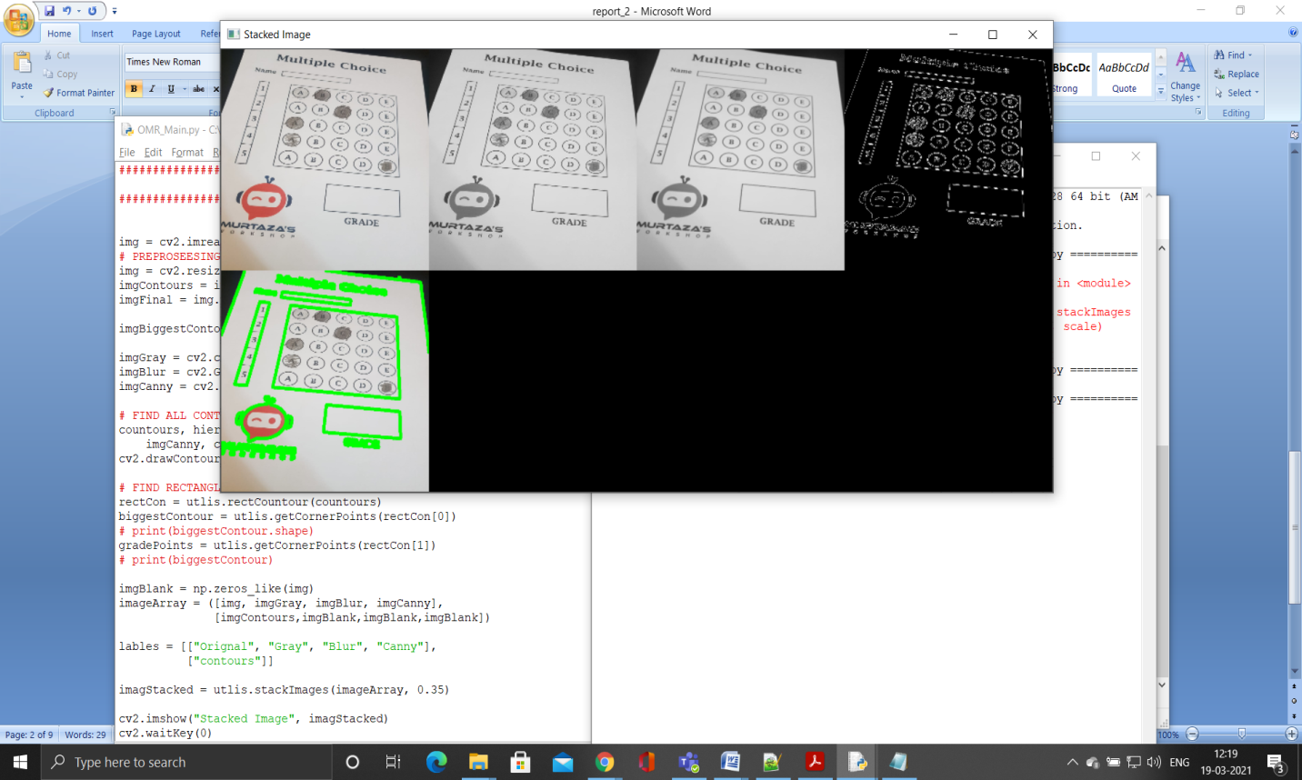
Output:
Description:
Recognize original image and Use OpenCV function convert that image into gray image->blur image->canny image. then recognize the rectangle in part in it based on area. After the recognize rectangle to sort all area and find biggest rectangle out of it. And all images are arranged in stacked image form.

Slide 9
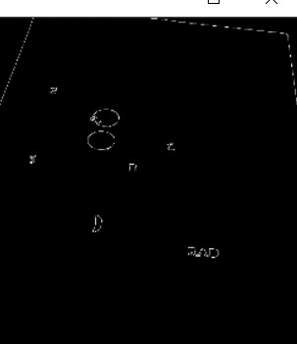
Testing:
Testcase 1:
When we change the parameter of Canny function to (10,500) then the output of the canny image as shown below

Slide 10
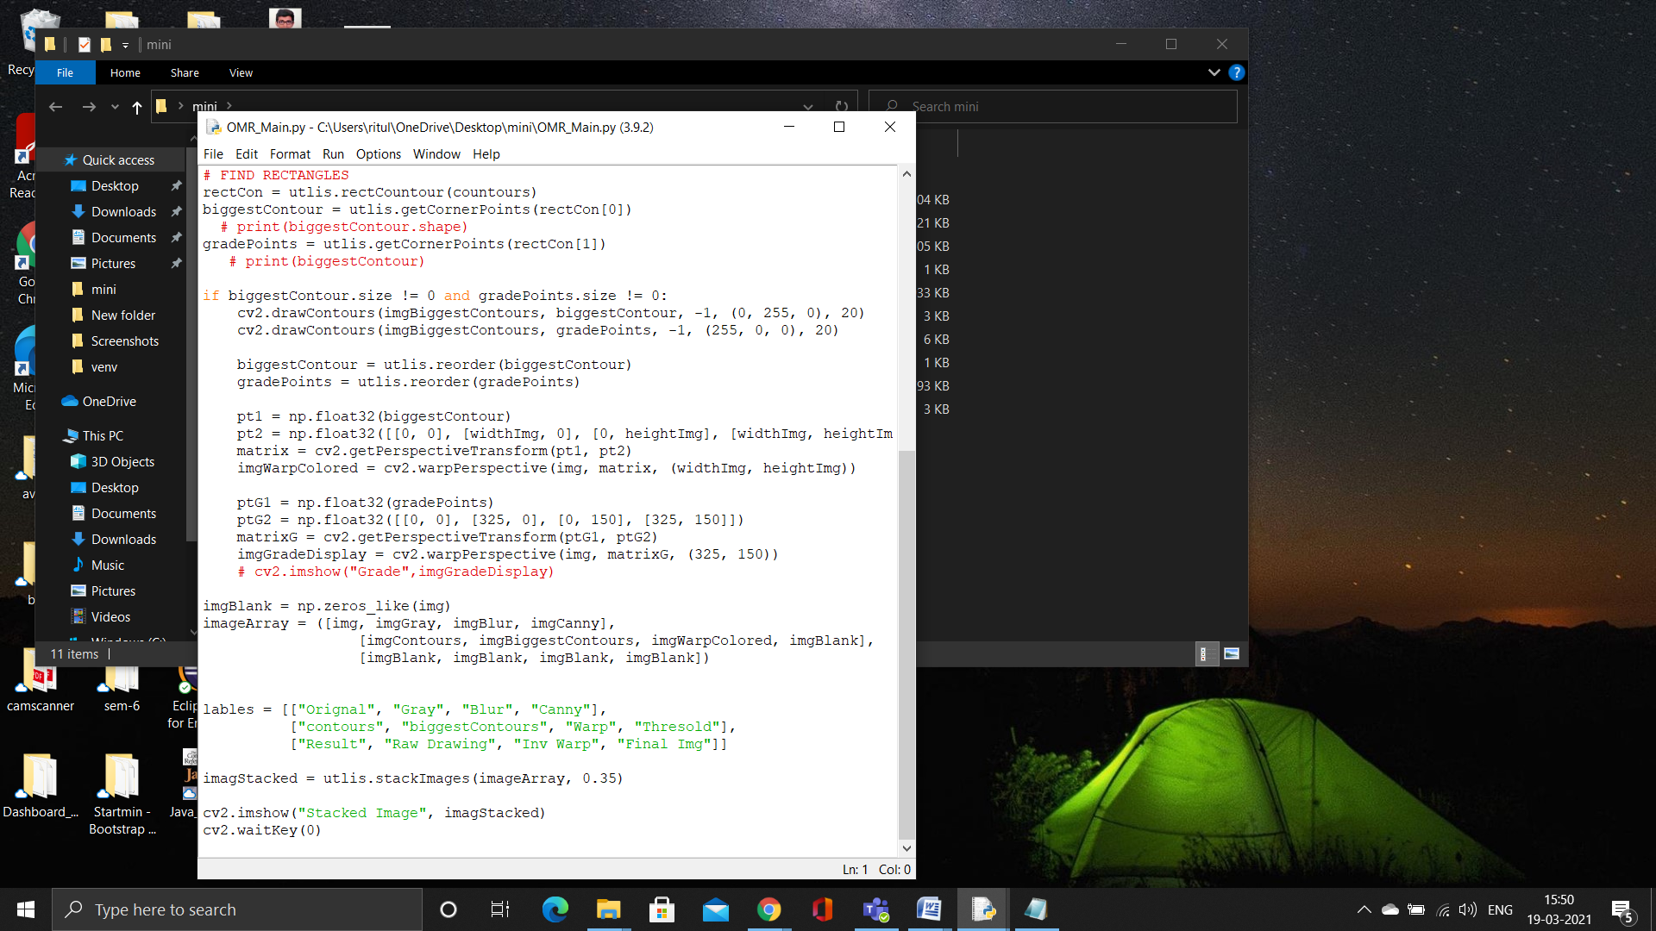
3) Document recognition module:
Code:

Slide 11
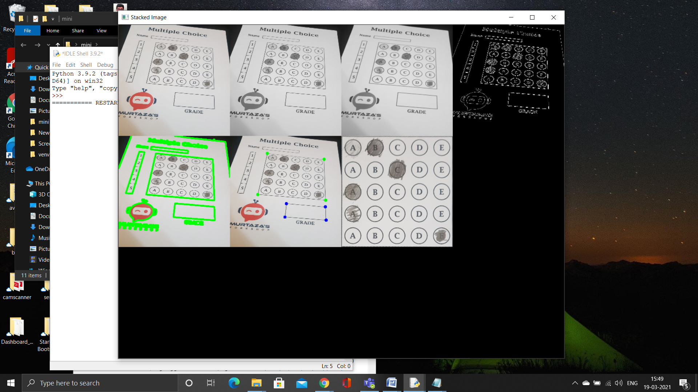
Output:
Description:
Then find the large rectangle from all the rectangles. After this image to convert warp image for large rectangle area. This warp image to find area of circle using OpenCV function.

Slide 12
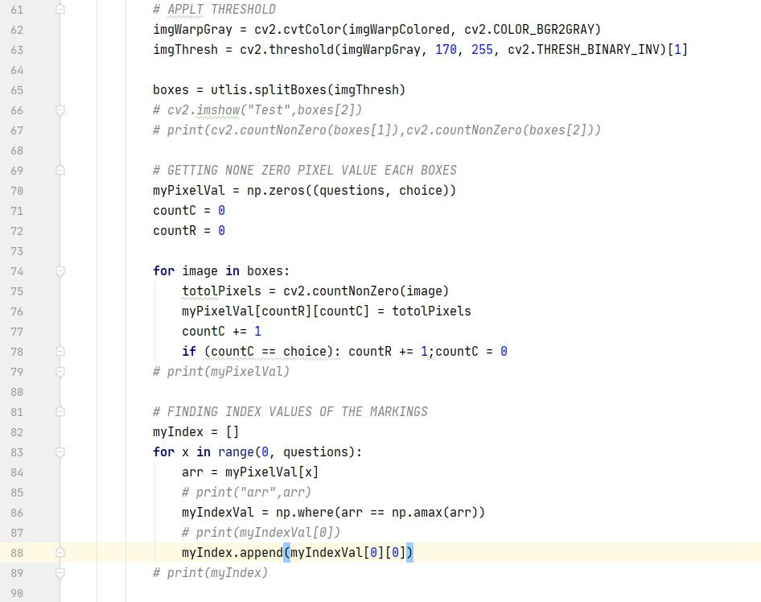
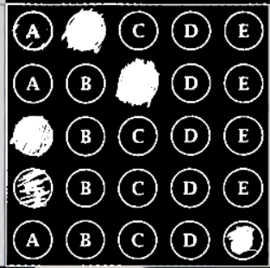
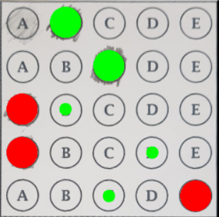
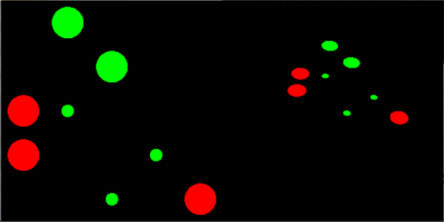
4)Document Editing Module:

Slide 14
Description:
We have passed the threshold parameter (170,255) in threshold function. Every bubble is spited and returned by the splitBoxes(). The pixel of every bubble is myPixelVal matrix.

Slide 15
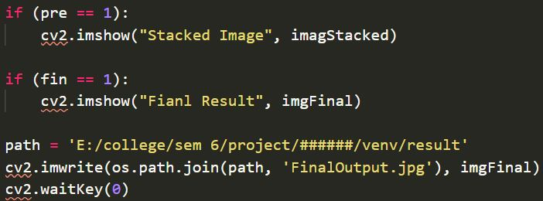
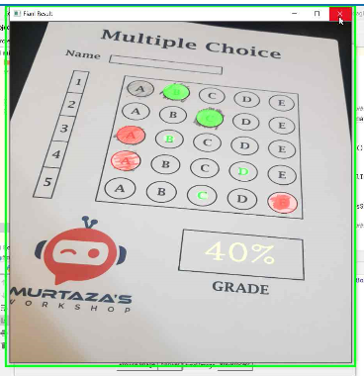
5) Document searching module:
Code:

Slide 16
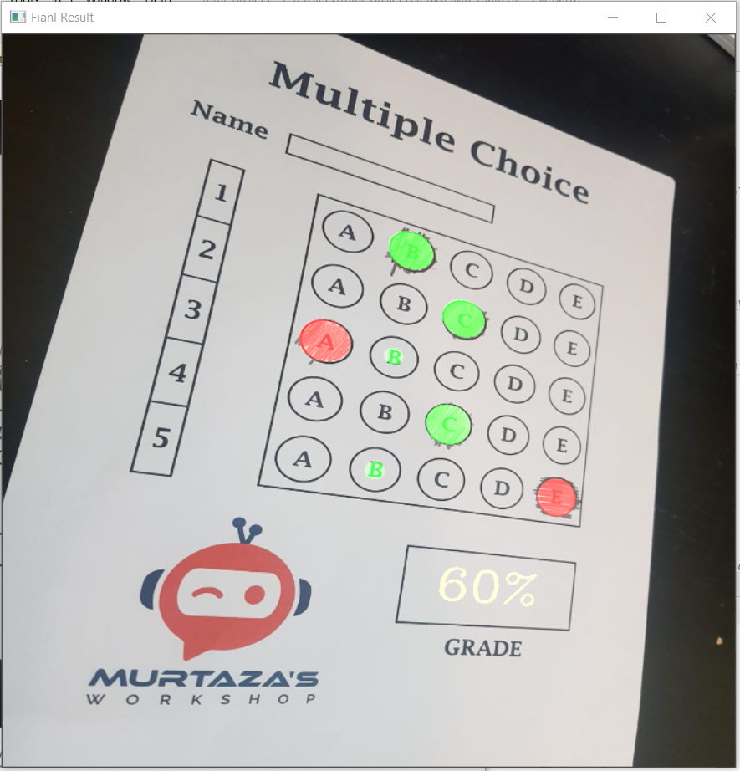
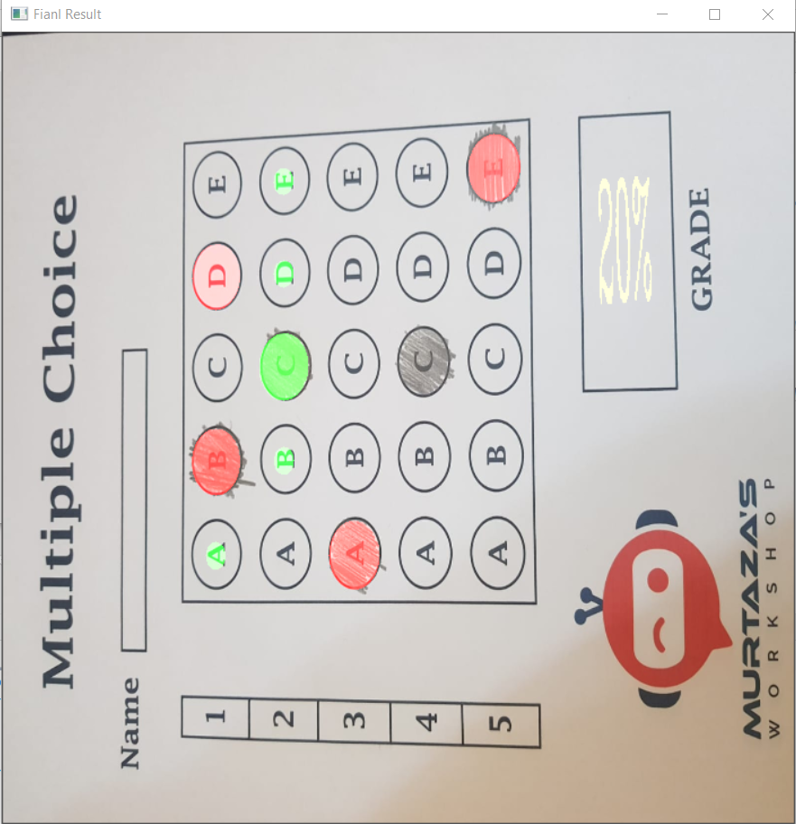
Test Case :
Test Case 1 Test Case: 2 Test Case 3:

Slide 17
Discription:
When press Final Image or Pre-Process Button pre = 1 at that time Stacked images will be displayed and when fin=1 at that time final image will be displayed. Result of the mark sheet will be stored in the given the given path.
Guide Remark:
Guide suggested that in the project we have to include mark sheet submission upload box so that user can manual submit the image.

Slide 18
Thank you!

